Slide 1
On Motivation
Uladzimir Abramchuk

Slide 2
Motivation
Remember a case when you were demotivated
Remember a case when you were highly motivated
What caused these feelings?
What is important for you in your work?
Notes:
5 minutes
Does anybody want to voice their experience?

Slide 3
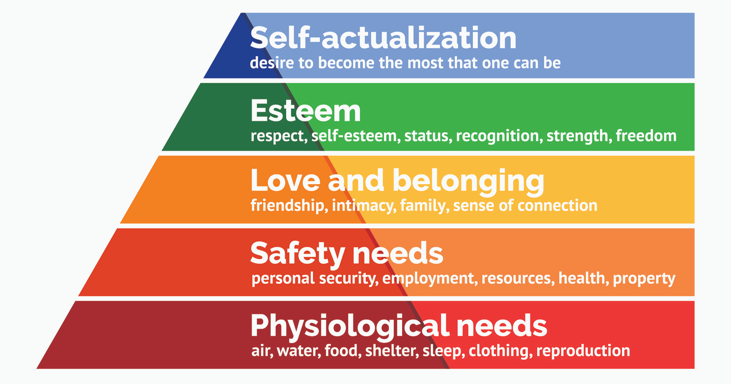
Maslow 's Motivation Theory
Notes:
ONE CANNOT ASCEND TO THE NEXT LEVEL UNLESS LOWER-LEVEL NEEDS ARE FULFILLED
Higher level drive more intensely than lower levels
Physiological: work conditions, salary, lunches
Safety: insurance, retirement plans
Love and belonging: team building, Friday parties, communication in the kitchen
Esteem: regular positive feedback, cool titles, promotions
Self-actualization: challenging tasks, freedom in certain areas, promotions, creativity celebration
BUT: priorities can change during life, needs can exist simultaneously

Slide 4
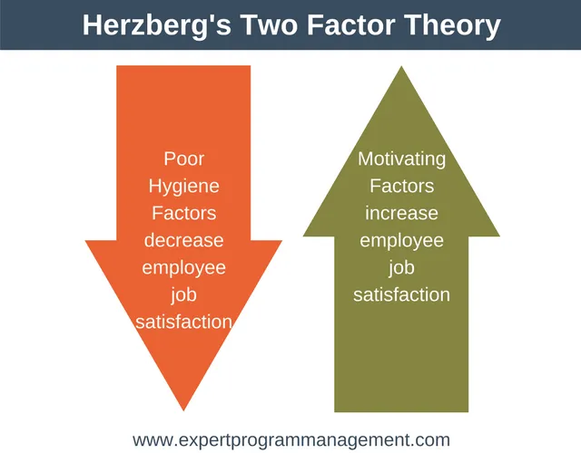
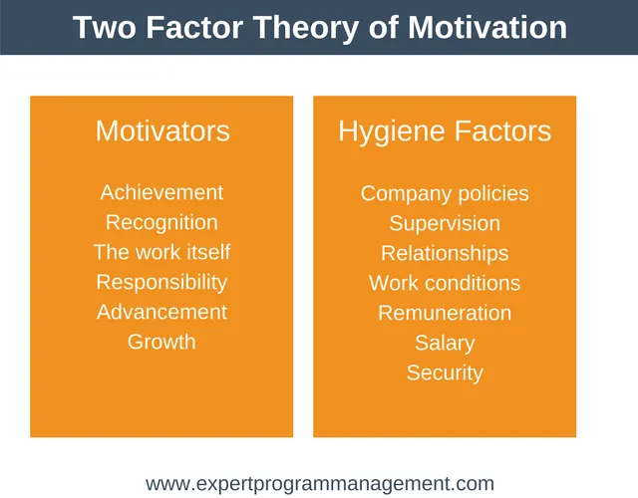
Hertzberg's Motivation Two-Factor Theory
Notes:
Some factors really do motivate but some just remove dissatisfaction
Factors differ in their lifetime, they may be short-lived or long-lived or permanent.
Improvements of hygienic factors won't motivate a lot. However, they are essential to reduce burnout and stress. They can provide a short boost.
For long-term improvements it's better to use motivators.
Same factors can be motivators for some people and hygienic for others.
Hertzberg confuses motivation and satisfaction and uses them interchangeably.

Slide 5
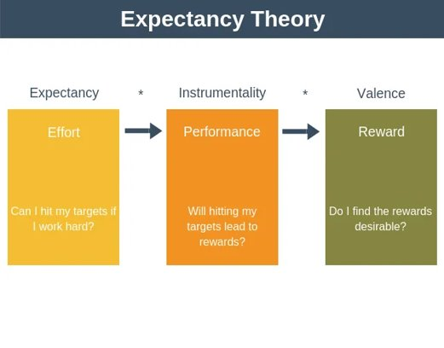
Vroom’s Theory of Expectancy
Motivation = V * I * E
Notes:
What matters is not reward but a link between effort and reward. If this dependency is direct then reward can motivate people. In such case employee should believe that putting effort will bring a reward. The less the correlation the less the motivation.
It's about WHAT PEOPLE THINK THE LINK IS.
Between effort and performance there are:
- skills
- job characteristics
- goals: clear, significant, etc.
- resources
- time
There is another link between performance and reward/punishment. Again, if there is direct link motivation will be higher. Like appraisal, bonus, promotion. Inner motivation also goes here.

Slide 6
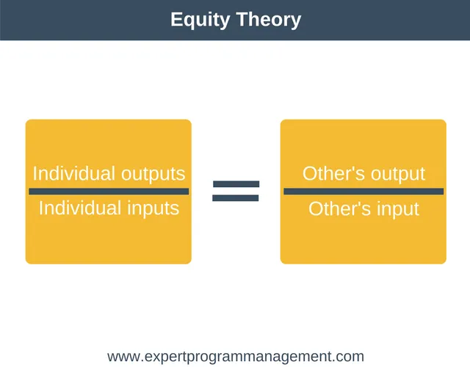
Adams’ Equity Theory of Motivation
Notes:
Do all people get equal reward for equal work?
Motivation doesn't depend on reward, but on the relation between effort and reward.
People look for different ways to get reward and calculate if it's worth it.

Slide 7
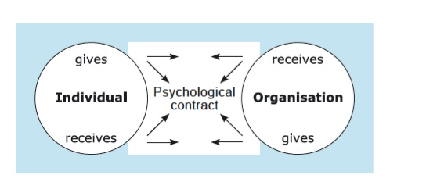
Psychological Contract
Notes:
Psychological contract is expectations related to mutual obligations.
Both employee and organization have expectations towards each other. It's also important to communicate these expectations to each other.
Employee expects: salary, vacations, work hours, anything he sees that other employees get.
If expectations doesn't match there will be problems.
Here person is not a rational actor. With time relation between employer and employee grows into some agreement. The more aligned both parties on this agreement the less probability of conflict there is.
Promises to employees: open and explicit like salary, implicit from the environment

Slide 8
Gerchikov’s Motivation Model
Motivation form \ Motivation type | Instrumental | Professional | Patriot | Host | Lumpen
Negative | Neutral | Forbidden | Possible | Forbidden | Basic
Monetary | Basic | Possible | Neutral | Possible | Neutral
Natural | Possible | Neutral | Possible | Neutral | Basic
Moral | Forbidden | Possible | Basic | Neutral | Neutral
Paternalism | Forbidden | Forbidden | Possible | Forbidden | Basic
Organizational | Neutral | Basic | Neutral | Possible | Forbidden
Taking part in management | Neutral | Possible | Possible | Basic | Forbidden
Notes:
Lumpen: minimizes effort, low qualification, low activity, agrees to low salary if everyone gets the same
Instrumental: interested in cost of labor not its content, price should be backed, important to provide for himself himself
Professional: interested in work, doesn't want to do what he's not interested in, freedom is important, wants to be the best in profession
Patriot: needs an idea, values public recognition
Host: takes responsibility willingly, hates control, prefers more freedom
Depending on the motivation type you can choose payment mode, whom to promote, how to organize work, how to communicate, etc.

Slide 9
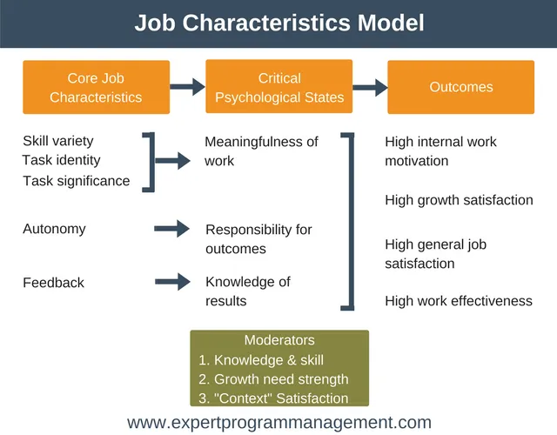
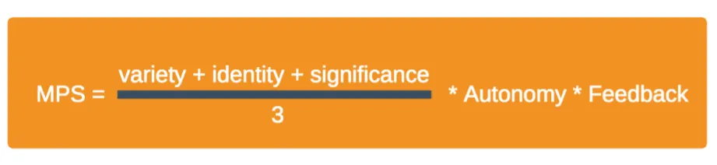
Job Characteristics Model
Notes:
Work can be structured and organized.
Too low skills variety can be boring, too high may cause cognitive overload and fragmentation.
Task identity is about wholeness of the work. Sometimes additional tasks can improve the wholeness and raise motivation. But they should be connected to main responsibilities and add to wholeness.
Task significance is about impact. If employee doesn't think about their work as important they will be demotivated. Show them significance of their contribution.
Autonomy is important so employee feels responsibility for success or failure. Ownership.
Feedback: internal and external. External is important to praise, to correct, to align. Internal comes from understanding that you worked well.

Slide 10
Gallup Q12 Employee Survey
Do you know what is expected of you at work?
Do you have the materials and equipment to do your work right?
At work, do you have the opportunity to do what you do best every day?
In the last seven days, have you received recognition or praise for doing good work?
Does your supervisor, or someone at work, seem to care about you as a person?
Is there someone at work who encourages your development?
At work, do your opinions seem to count?
Does the mission/purpose of your company make you feel your job is important?
Are your associates (fellow employees) committed to doing quality work?
Do you have a best friend at work?
In the last six months, has someone at work talked to you about your progress?
In the last year, have you had opportunities to learn and grow?

Slide 11
People!

Slide 12
Thank you!

